Slide 1

Power Curve Interpolation, What We’ve Learnt?
NREL, Boulder, US
10th August 2016
Peter Stuart (RES), Daniel Marmander (NPC) &
Axel Albers (Wind Guard)

Slide 2
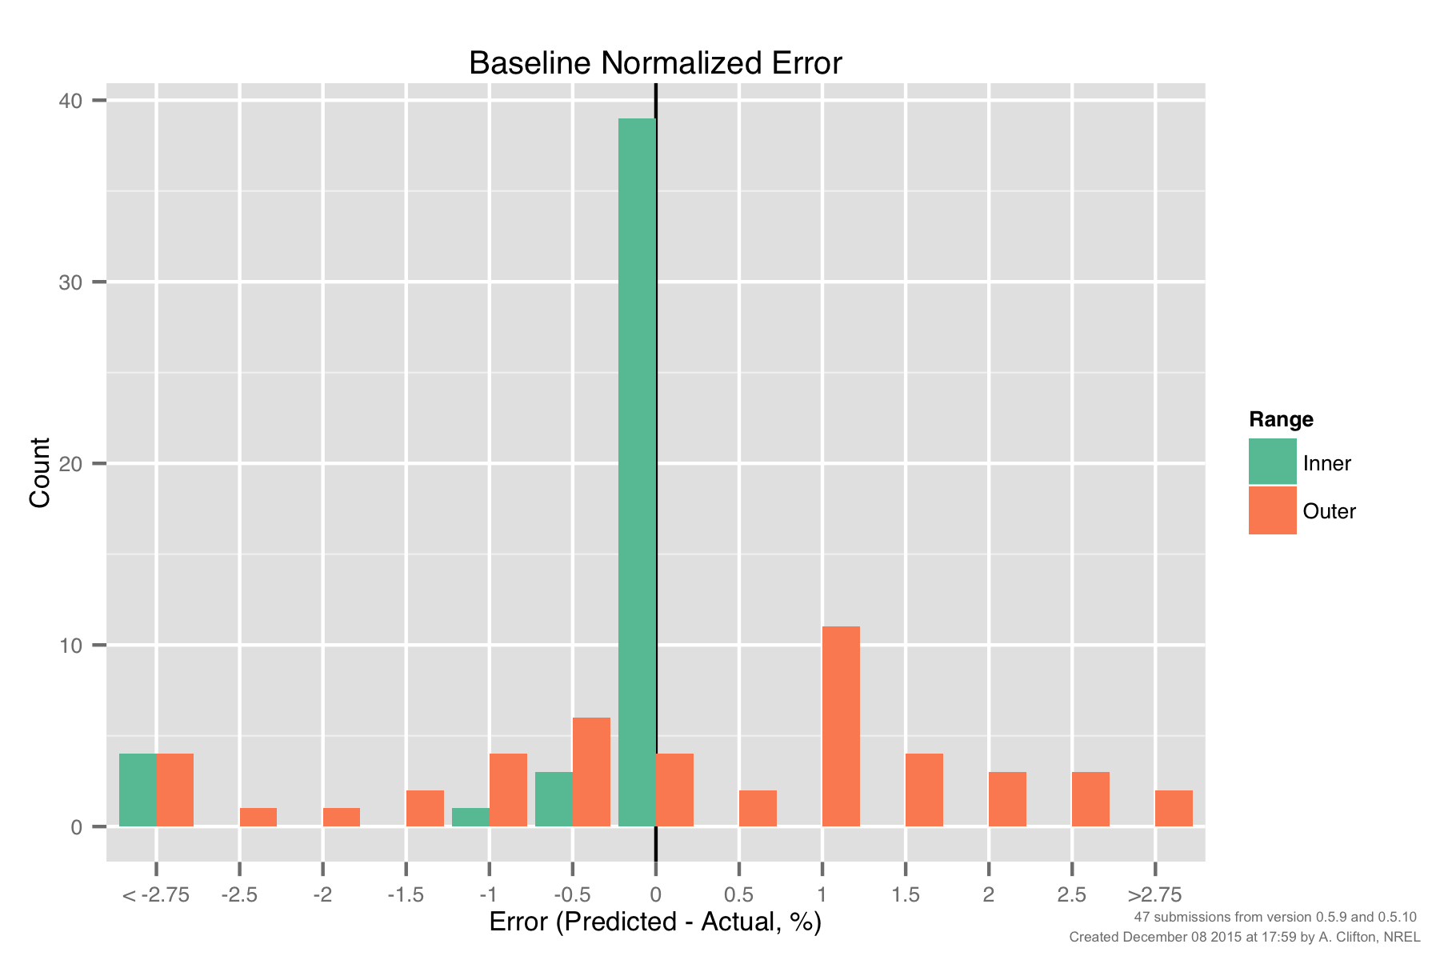
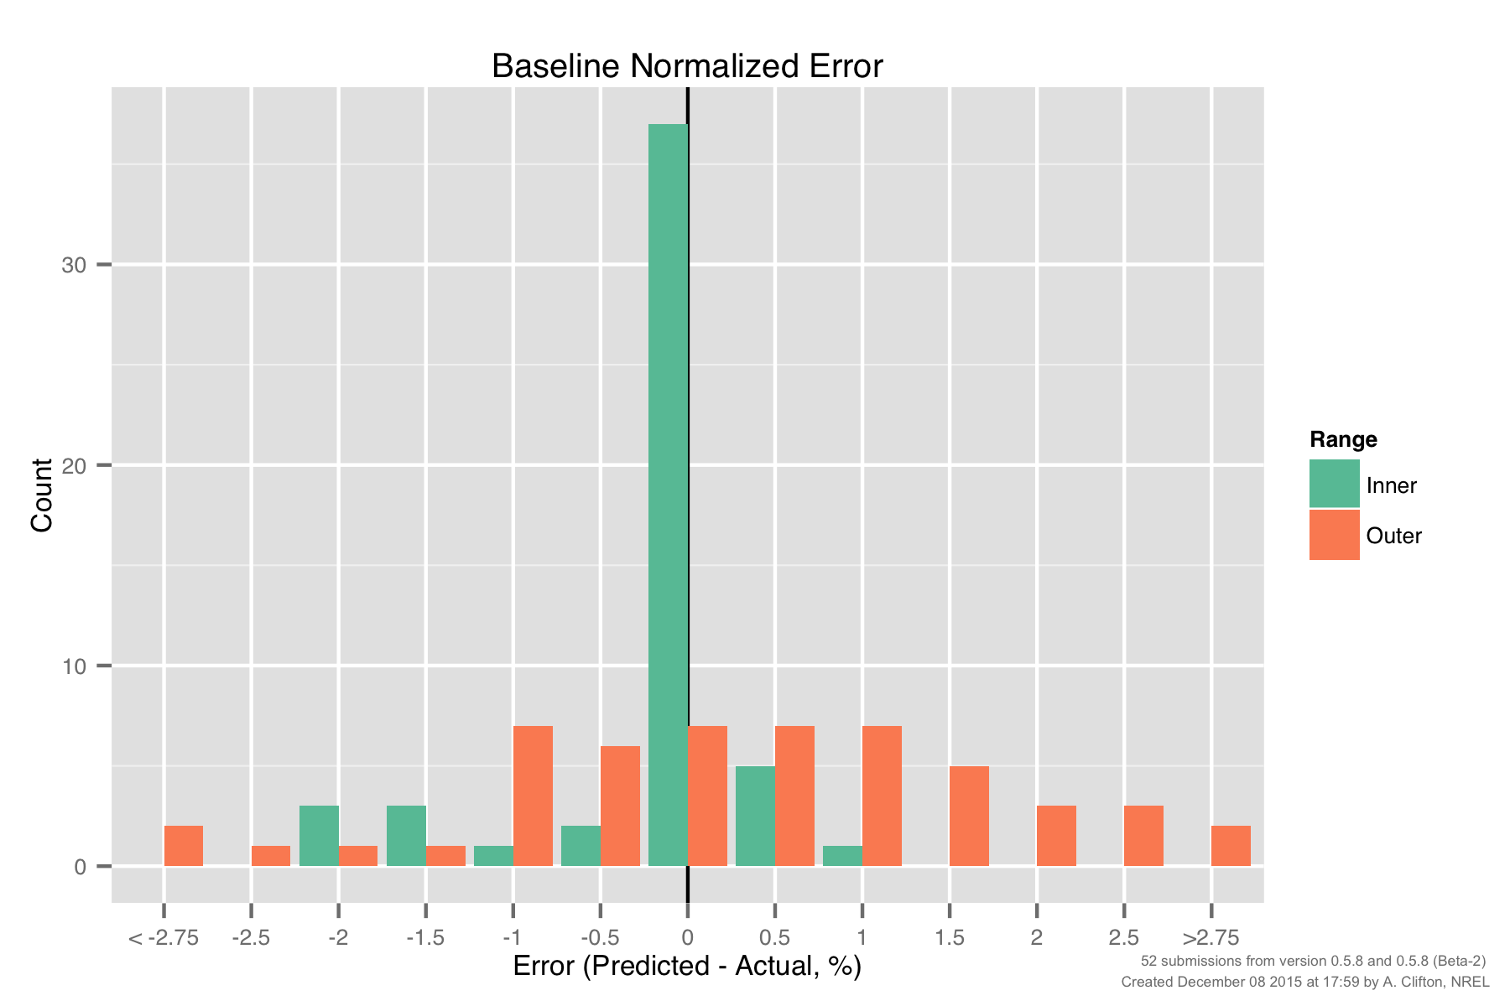
PCWG-Share-01: Baseline Error, Inner vs Outer Range
Version 0.5.8
(linear interpolation)
Version 0.5.9/10
(cubic interpolation)
What is causing these errors?

Slide 3
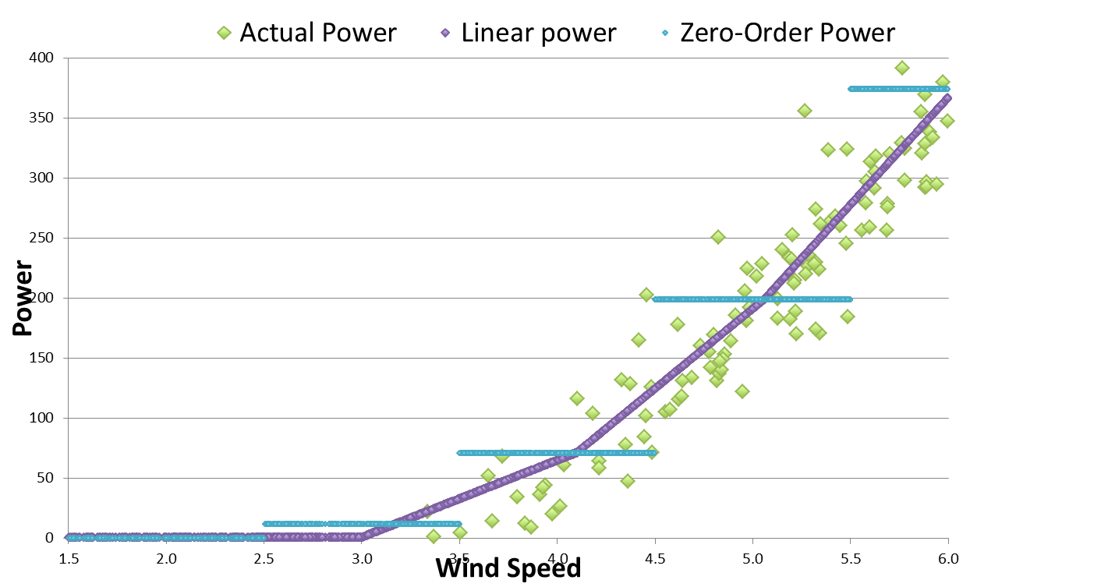
Interpolation Issue: V0.5.8 (Liner Interpolation)
Linear Interpolation: v0.5.8 and earlier, improvement for individual data points but noticeable over prediction at low wind speed

Slide 4
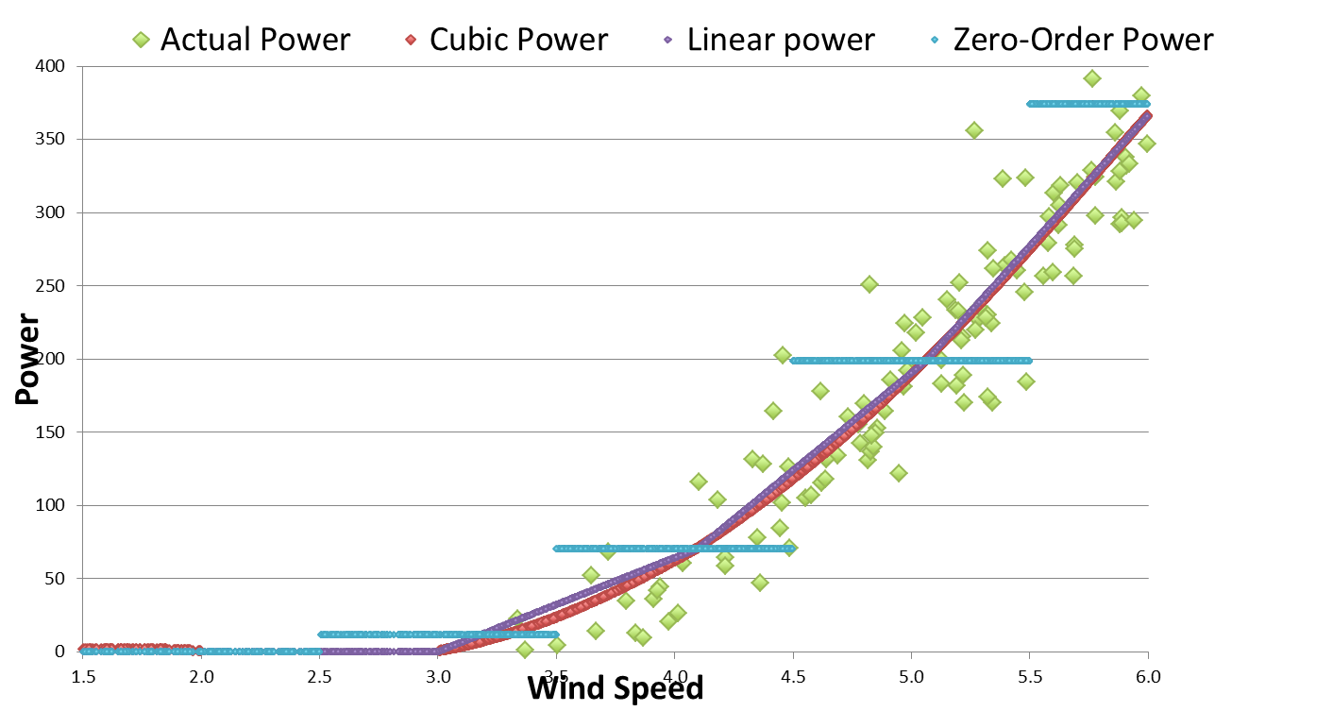
Interpolation Issue: V0.5.9 (Cubic Interpolation)
Cubic interpolation: introduced in v0.5.9 for PCWG-Share-01. Noticeably reduces error at low wind speed compared to linear.

Slide 5
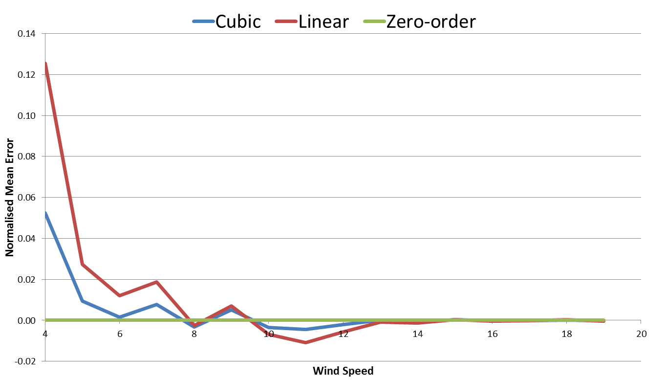
Typical ‘By Wind Speed’ Signature of Interpolation Issue
Normalised Mean Error (NME) by wind speed:
Cubic interpolation has similar but smaller errors than linear.
Zero-order has 0 error by definition
Cubic and linear interpolators over estimate data at the ankle
Cubic and linear interpolators under estimate data at the knee

Slide 6
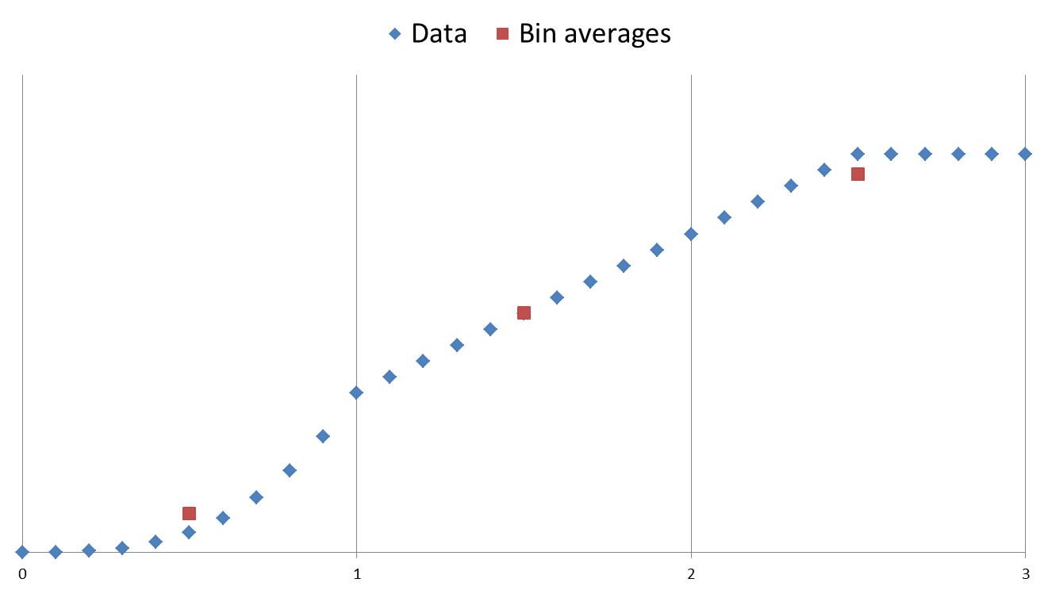
Residual Error
Main reason for residual error: Bin averages are used as interpolation points. Unfortunately the bin averages do not lie exactly on the curve when the underlying function is non-linear.
Cubic
(Convex)
Clipped
(Concave)
Linear
The bin average, (avg(x), avg(y)),
is below the curve
The bin average, (avg(x), avg(y)),
is above the curve
The bin average, (avg(x), avg(y)),
is on the curve

Slide 7
What do we really need?
Power Performance Context
In order to conduct a power performance test we need a reference curve which can be compared to the measured curve.
In this context bin averages work fine as if the reference curve is supplied as bin averages then if can be compared to a bin average measured curve (with consistently defined bins).
Resource Assessment Context
Ideally we want a continuous power curve which can be used with to determine the power curve for any wind speed.
Note: This requirement is particularly pertinent for time series yields.

Slide 8
Interpolation Strategy
Bin averages ≠ continuous power curve
Bin Averages + Interpolation Strategy = continuous power curve
Which interpolation strategy works best?

Slide 9
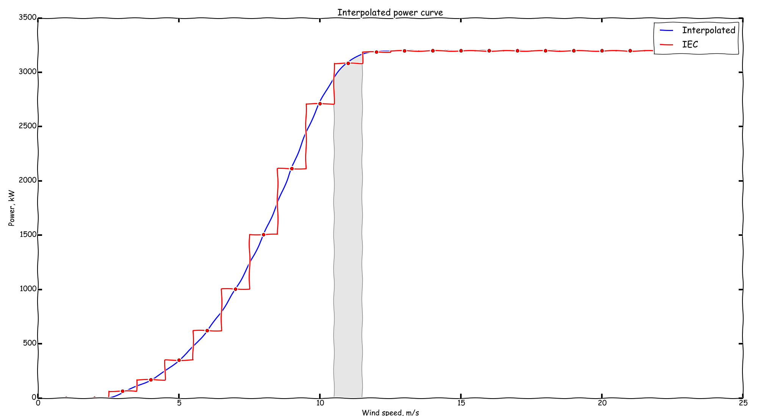
Does the continuous curve need to intersect the bin averages?
Zero order
Average of blue curve over bin ≠ bin average
Power Curve Interpolation, Daniel Marmander (Natural Power), PCWG Present 15 March 2016.

Slide 10
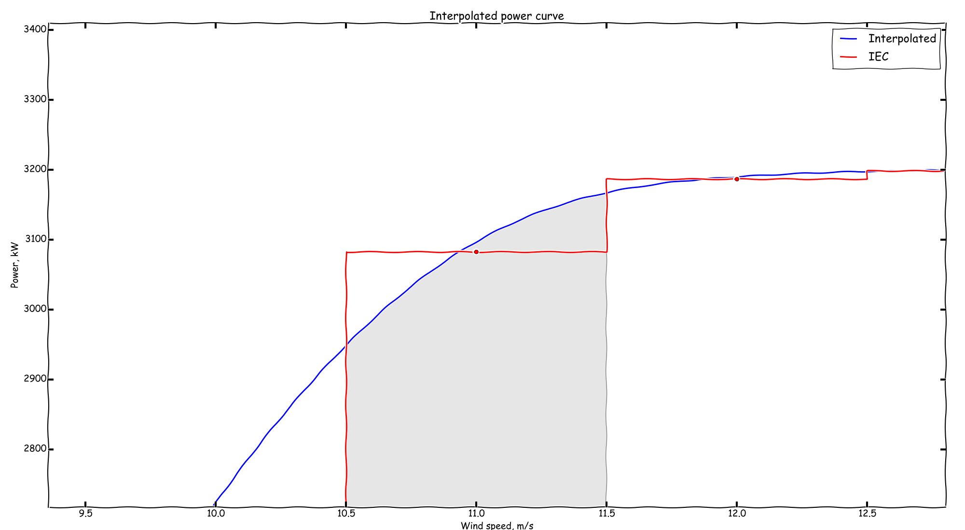
Shifting the interpolation points from the bin averages can be used to minimise errors…
Zero order
Average of blue curve over bin = bin average
Iterative procedure used to determine interpolation points which when interpolated and averaged over the bin give the bin average.
Power Curve Interpolation, Daniel Marmander (Natural Power), PCWG Present 15 March 2016.

Slide 11
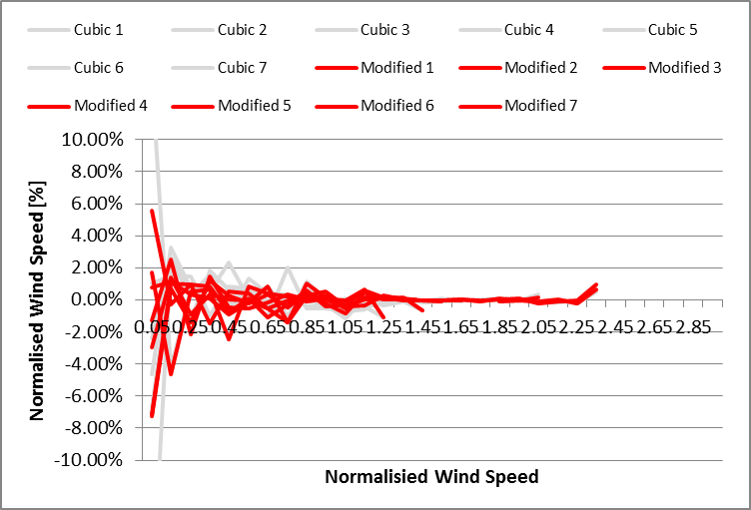
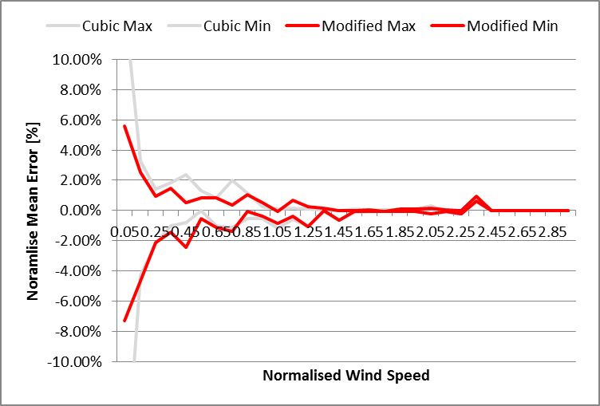
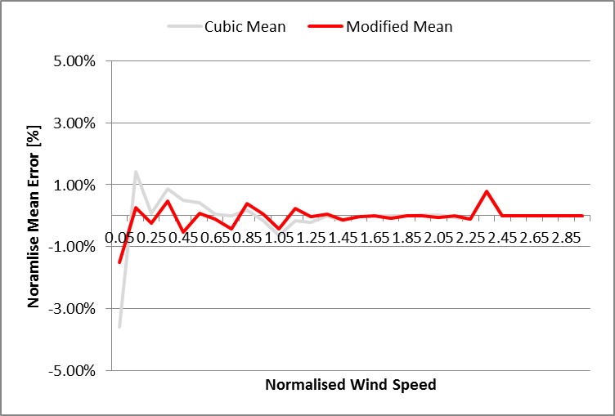
Comparison Cubic Interpolation vs Modified Method

Slide 12
Questions?

